Slide 1
Analysis of Algorithms
Input
Algorithm
Output
An algorithm is a step-by-step procedure for
solving a problem in a finite amount of time.

Slide 2

Ultimate Goal in Algorithm Design
Complete Tasks Efficiently
Efficiency is measured in terms of time and space
Notes:
By analyzing, we can compare algorithms, and depending on the task, pick the best ones.

Slide 3
Running Time Analysis
Determine the running time increases related to the size of the input.
Input = n values
Notes:
Cant make any assumptions regarding n!!
Don’t assume n will always be small!!
Running Time Analysis, and not making assumptions for n make for a timeless concept that translates from old computing systems to modern machines

Slide 4


Definitions
RATE OF GROWTH
The rate at which running time increases as a function of input.
LOWER ORDER TERMS
When given an approximation of the rate of growth of a function, we tend to drop the lower order terms as they are less significant to higher order terms.
Notes:
Cant make any assumptions regarding n!!
Don’t assume n will always be small!!
Running Time Analysis, and not making assumptions for n make for a timeless concept that translates from old computing systems to modern machines

Slide 5
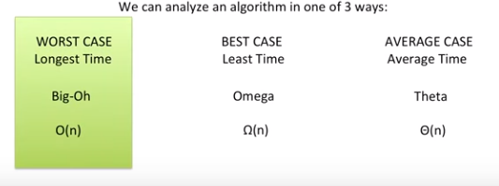
Types of Analysis
Notes:
Cant make any assumptions regarding n!!
Don’t assume n will always be small!!
Running Time Analysis, and not making assumptions for n make for a timeless concept that translates from old computing systems to modern machines

Slide 6
Running Time
Most algorithms transform input objects into output objects.
The running time of an algorithm typically grows with the input size.
Average case time is often difficult to determine.
We focus on the worst case running time.
Easier to analyze
Crucial to applications such as games, finance and robotics

Slide 7
Pseudocode
Example: find max element of an array
High-level description of an algorithm
More structured than English prose
Less detailed than a program
Preferred notation for describing algorithms
Hides program design issues
Algorithm arrayMax(A, n)
Input array A of n integers
Output maximum element of A
currentMax ← A[0]
for i ← 1 to n − 1 do
if A[i] > currentMax then
currentMax ← A[i]
return currentMax

Slide 8
Pseudocode Details
Control flow
if … then … [else …]
while … do …
repeat … until …
for … do …
Indentation replaces braces
Method declaration
Algorithm method (arg [, arg…])
Input …
Output …
Method/Function call
var.method (arg [, arg…])
Return value
return expression
Expressions
Assignment (like = in C++)
Equality testing (like == in C++)
n² Superscripts and other mathematical formatting allowed

Slide 9
The Random Access Machine (RAM) Model
A CPU
An potentially unbounded bank of memory cells, each of which can hold an arbitrary number or character
2
1
0
Memory cells are numbered and accessing any cell in memory takes unit time.

Slide 10
Primitive Operations
Basic computations performed by an algorithm
Identifiable in pseudocode
Largely independent from the programming language
Exact definition not important (we will see why later)
Assumed to take a constant amount of time in the RAM model
Examples:
Evaluating an expression
Assigning a value to a variable
Indexing into an array
Calling a method
Returning from a method

Slide 11
Counting Primitive Operations
By inspecting the pseudocode, we can determine the maximum number of primitive operations executed by an algorithm, as a function of the input size
Algorithm arrayMax(A, n)
# operations
currentMax ← A[0] 2
for (i =1; i<n; i++) 2n
(i=1 once, i<n n times, i++ (n-1) times)
if A[i] > currentMax then 2(n − 1)
currentMax ← A[i] 2(n − 1)
return currentMax 1
Total 6n −1

Slide 12
Estimating Running Time
Algorithm arrayMax executes 6n − 1 primitive operations in the worst case. Define:
a = Time taken by the fastest primitive operation
b = Time taken by the slowest primitive operation
Let T(n) be worst-case time of arrayMax. Then a (6n − 1) ≤ T(n) ≤ b(6n − 1)
Hence, the running time T(n) is bounded by two linear functions

Slide 13
Growth Rate of Running Time
Changing the hardware/ software environment
Affects T(n) by a constant factor, but
Does not alter the growth rate of T(n)
The linear growth rate of the running time T(n) is an intrinsic property of algorithm arrayMax

Slide 14
n | logn | n | nlogn | n² | n³ | 2^{n}
4 | 2 | 4 | 8 | 16 | 64 | 16
8 | 3 | 8 | 24 | 64 | 512 | 256
16 | 4 | 16 | 64 | 256 | 4,096 | 65,536
32 | 5 | 32 | 160 | 1,024 | 32,768 | 4,294,967,296
64 | 6 | 64 | 384 | 4,094 | 262,144 | 1.84 * 10¹⁹
128 | 7 | 128 | 896 | 16,384 | 2,097,152 | 3.40 * 10³⁸
256 | 8 | 256 | 2,048 | 65,536 | 16,777,216 | 1.15 * 10⁷⁷
512 | 9 | 512 | 4,608 | 262,144 | 134,217,728 | 1.34 * 10¹⁵⁴
1024 | 10 | 1,024 | 10,240 | 1,048,576 | 1,073,741,824 | 1.79 * 10³⁰⁸
The Growth Rate of the Six Popular functions

Slide 15
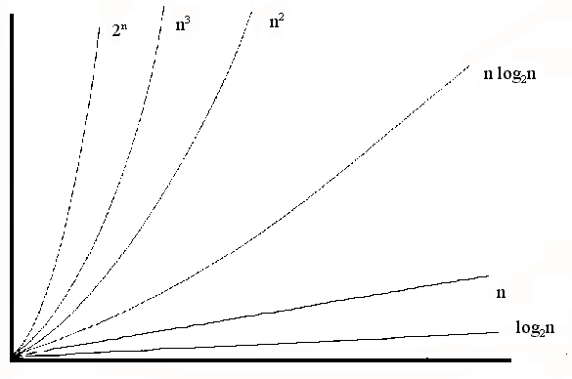
Common growth rates

Slide 16
Big-Oh Notation
To simplify the running time estimation, for a function f(n), we drop the leading constants and delete lower order terms.
Example: 10n³+4n²-4n+5 is O(n³).
Notes:
Hope for the best, plan for the worst!

Slide 17
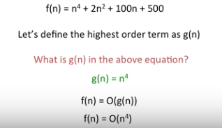
Big-Oh Notation
Notes:
Hope for the best, plan for the worst!

Slide 18
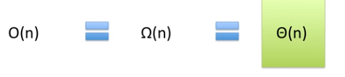
Is it best to always use Big-Oh Notation?
Most of the time, YES.
However…
Notes:
Just a formality and widely accepted practice!

Slide 19



Example 1
Loop happens n times
Constant Operation

Slide 20



Example 2
Loop happens n/2 times
Constant Operation
Notes:
Eventhough the loop only iterates half as much as the last example, they are both O(n)!

Slide 21
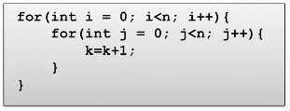

Example 3 Nested Loops
Outside Loop has inside happen n times!
Inside Loop happens n
Constant Operation

Slide 22
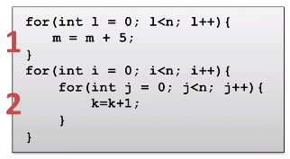

Example 4 Consecutive Statements
Single Loop
Operation
Nested Loops

Slide 23
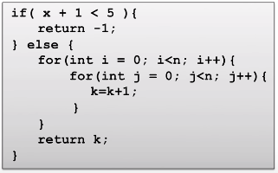

Example 5 If-Then-Else
Constant
Constant
Outer Loop
Inner Loop
Constant
f(n)=
C₀
+ C₁
+ n
x n
x C₂

Slide 24
Big-Oh Rules
If is f(n) a polynomial of degree d, then f(n) is O(n^{d}), i.e.,
Drop lower-order terms
Drop constant factors
Use the smallest possible class of functions
Say “2n is O(n)” instead of “2n is O(n²)”
Use the simplest expression of the class
Say “3n + 5 is O(n)” instead of “3n + 5 is O(3n)”

Slide 25
Tips when analyzing
Be mindful of where loops start and end. Especially for nested loops
If the best case, average case, and worse case are equal, use Theta!
Know your orders when looking for the highest order!

Slide 26
End of Presentation

